Slide 1


UDP Protocol
Made by Sahand Esmaeilzadeh
Sharif University of Technology
Dr. Amin Foshati

Slide 2

Table Of Contents
Transport Layer
UDP Checksum
Introduction to UDP
UDP Usages
UDP Header
Conclusion

Slide 3
The Transport Layer: Purpose and Functions
Key Functions
Role of the Transport Layer
Segmentation and Reassembly
The transport layer acts as a bridge between application-layer services and lower-layer networking functionalities. It ensures data sent from a source application reaches the intended destination application reliably and efficiently.
End-to-End Communication
Multiplexing and Demultiplexing
Error Detection and Correction
Flow Control
Reliability and Connection Management

Slide 4
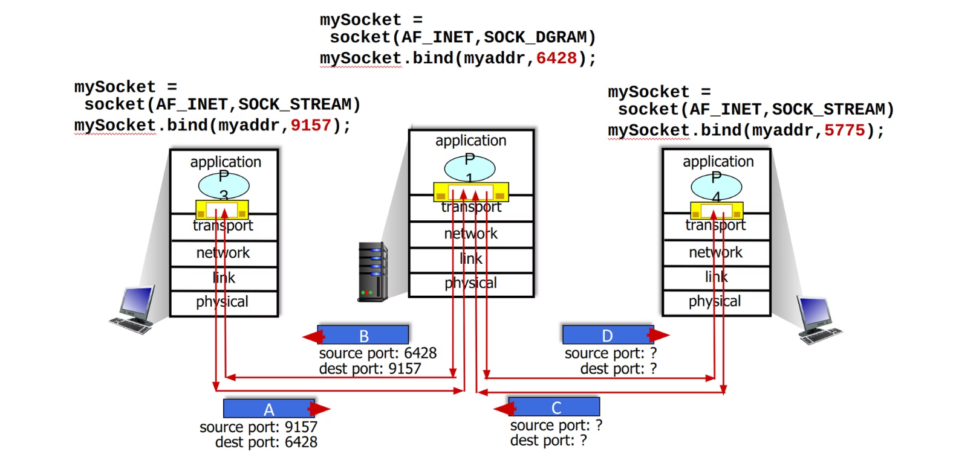
Connectionless Demultiplexing

Slide 5
Introduction to the User Datagram Protocol (UDP)
1980 by David P. Reed.
RFC 768
Simpler and Faster Alternative to TCP
RFC 768 defines UDP and its details.
David P. Reed introduced UDP in 1980, focusing on simplicity and speed.
UDP is faster and simpler than TCP (1974), with less overhead.

Slide 6
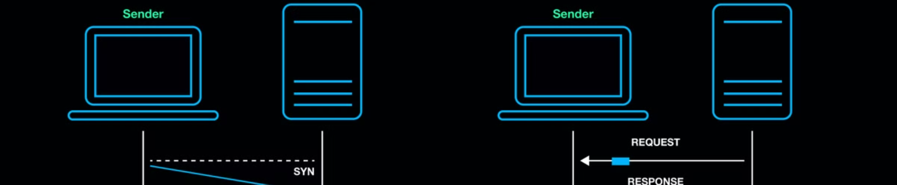
Characteristics of UDP
Connectionless Communication
Best-Effort Delivery
Checksum for Error Detection
UDP does not establish a formal connection before transmitting data. Each packet is sent independently.
UDP operates on a best-effort basis, meaning there is no guarantee that packets will arrive in order or at all.
UDP includes a simple checksum for basic error detection, but it does not offer correction mechanisms.
Supports Broadcast and Multicast
Low Overhead
UDP allows data to be sent to multiple recipients simultaneously using broadcast and multicast communication. Usually in local networks.
UDP's lack of connection management and reliability mechanisms results in minimal overhead, making it faster than TCP.

Slide 7

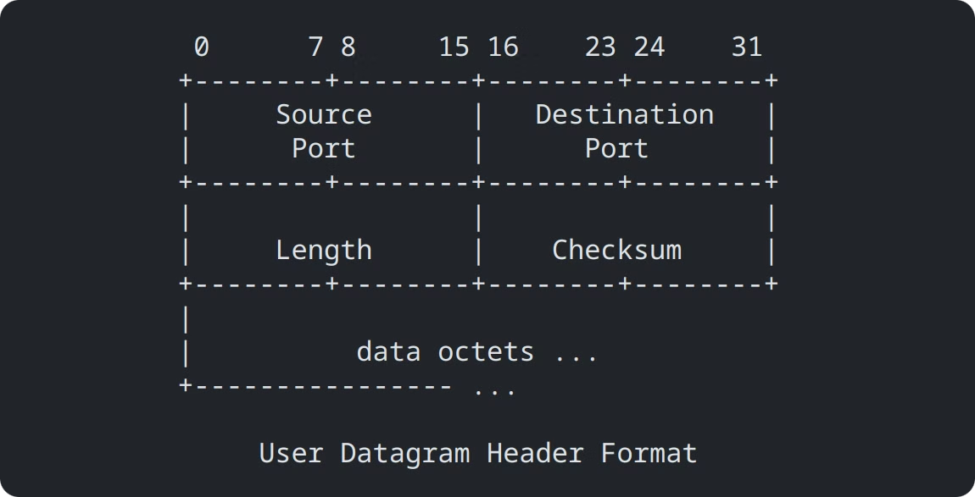
UDP Header Format
Field
Description
Source Port
Indicates the port of the sending process. (optional)
Destination Port
Indicates the port of the receiving process.
Length
The length of the UDP datagram, including header and data.
Checksum
A simple checksum for basic error detection. (optional)

Slide 8

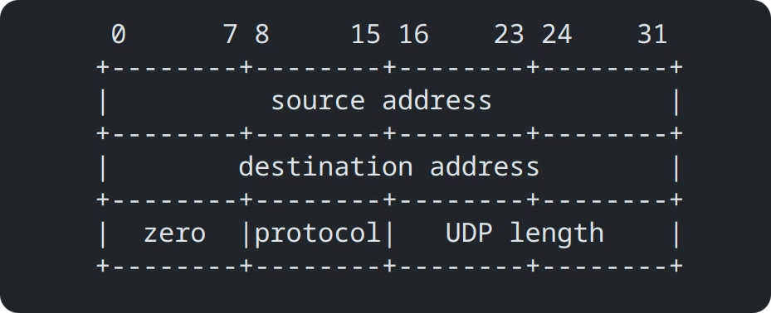
Pseudo Header for Checksum Calculation
The UDP checksum calculation involves a pseudo header that includes the source and destination IP addresses, protocol type (UDP), and UDP length. This pseudo header is used to ensure that the checksum is calculated across the entire packet, including the IP header.

Slide 9
UDP Checksum Calculation
The checksum calculation involves computing the one's complement sum of all 16-bit words in the pseudo header, UDP header, and data. The one's complement of the final sum is then used as the checksum value. If the checksum is 0x0000, it is transmitted as 0xFFFF.

Slide 10
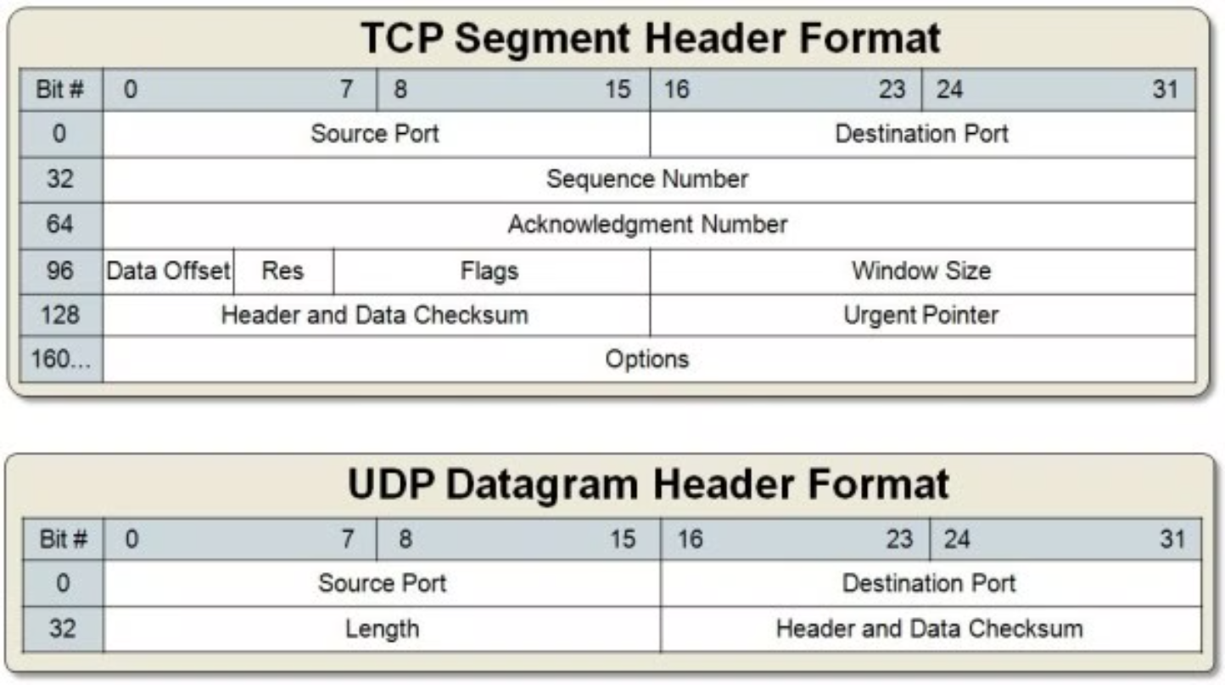
TCP and UDP Headers

Slide 11
Why Choose UDP Over TCP?
UDP Advantages
When to Choose UDP
Low Latency
UDP is preferred when speed and low overhead are more important than reliability. It is suitable for real-time applications, broadcast scenarios, and situations where application-level error handling is sufficient.
Reduced Overhead
Broadcast and Multicast Support
Application-Controlled Reliability
Stateless Communication

Slide 12




When to Choose UDP
VoIP
Online Gaming
Real-time voice communication requires low latency.
Minimizing latency is essential for responsive gameplay.
Live Streaming
Network Discovery
Fast transmission is crucial for smooth video playback.
UDP is used for broadcasting network information.

Slide 13
What Protocols Are based on UDP
Networking & Internet Services
Real-Time Communication
Streaming & Media
DNS (53) – Domain name resolution
VoIP & SIP – Low-latency voice calls
RTP & RTSP (554) – Live streaming
DHCP (67/68) – Dynamic IP allocation
WebRTC – Browser-based video & audio
Multicast IPTV – Efficient content delivery
SNMP (161/162) – Network management
NTP (123) – Time synchronization
Gaming & File Transfer
VPN & Security
Game Servers – Real-time multiplayer gaming
IKE (500/4500) – IPSec VPNs
TFTP (69) – Lightweight file transfer
WireGuard (51820) – Secure tunneling
QUIC (443) – Faster web transport

Slide 14

Conclusion
UDP is a fundamental transport layer protocol that prioritizes speed and efficiency over reliability. Understanding the strengths and limitations of UDP allows network engineers and developers to choose the appropriate protocol for their specific needs, balancing speed, reliability, and resource usage effectively.

Slide 15
Sources
Thank You For Your Attention
RFC 768

